Slide 1
Unit VI INTERACTIVE DASHBOARDS AND STORY POINTS IN TABLEAU
Prepared by:
Amanpal Singh
Assistant Professor
LPU, Phagwara

Slide 2
Creating & Designing dashboard
Add motions
Adding interactivity with actions
Dashboard layout and formatting
Add extra detail to visualization using Marks Shelf: Size, Shape, Labels, Details, Tooltips in visualization
Sharing and collaborating dashboards
Story Points and how to create them,
Designing effective slide presentations to showcase data story
Publish online business dashboards
Exporting Pdfs, Sharing Dashboard Securely

Slide 3
1. Creating & Designing dashboard
Be clear about what you're trying to achieve – your board’s purpose will inform its design
Only include what’s important – everything should support your board’s intent
Consider data ink ratio – avoid decorative elements that don’t communicate data
Round your numbers – being overly precise can get in the way of important changes
Use the most efficient visualization – a good visualization should be understood quickly
Group your related metrics – make your metrics easy to find

Slide 4
Be consistent – using the same visualizations and layouts makes comparing easier
Use size and position to show hierarchy – make it clear to the viewer what’s most important
Give your numbers context – help your viewers know if a number is good, bad, normal or unusual
Use clear labels for your audience – keep them short and self explanatory
Remember it’s for people – it’s ok to break the rules if it increases engagement
Keep evolving your dashboards – check that your dashboard is encouraging the right behaviour

Slide 5
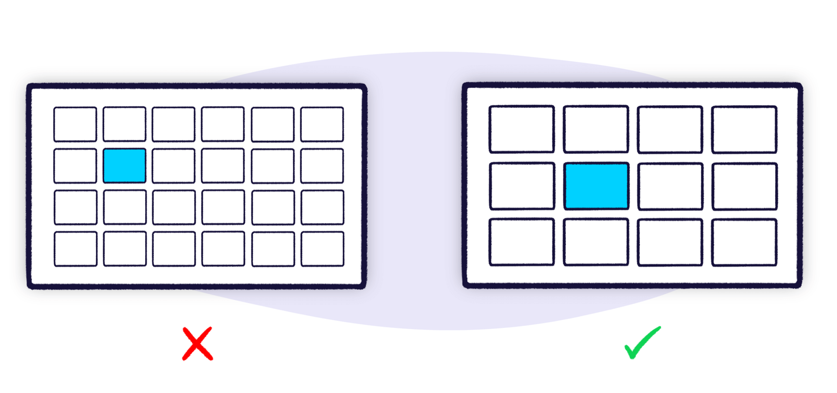
Include only the most important content
Content is key when it comes to dashboarding. If you’re not showing useful metrics then it doesn’t matter how you arrange them.
https://www.geckoboard.com/best-practice/dashboard-design/

Slide 6
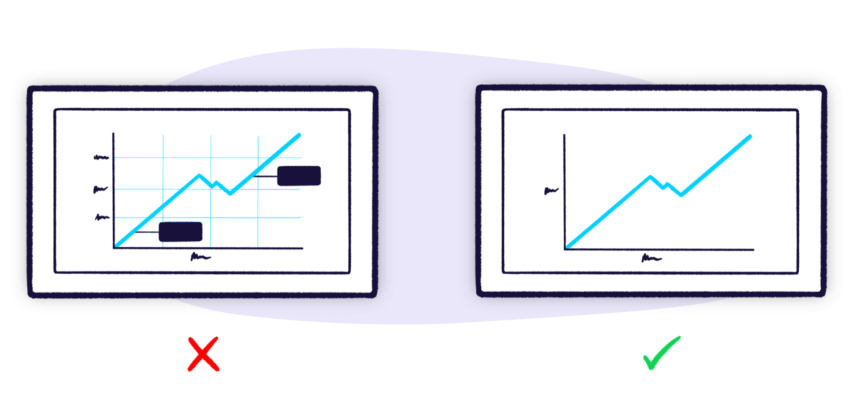
Consider data ink ratio
Another way to improve your dashboard design is by reducing the amount of visual noise. The American statistician, Edward Tufte coined a term for this: data ink ratio.

Slide 7
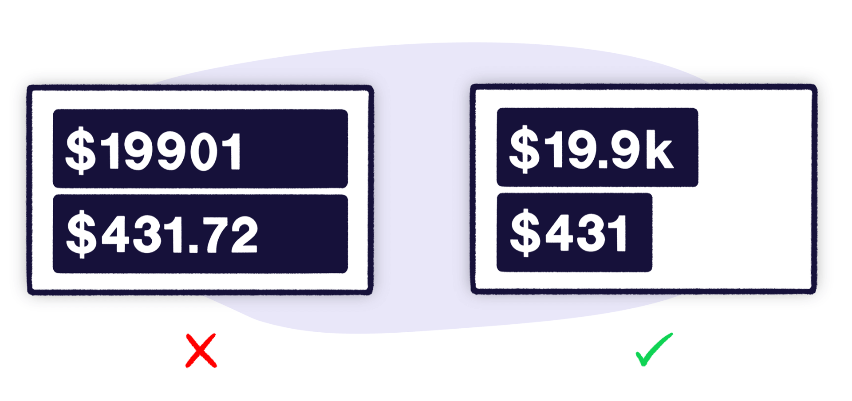
Round your numbers
When displaying numbers, try not to be overly precise.

Slide 8
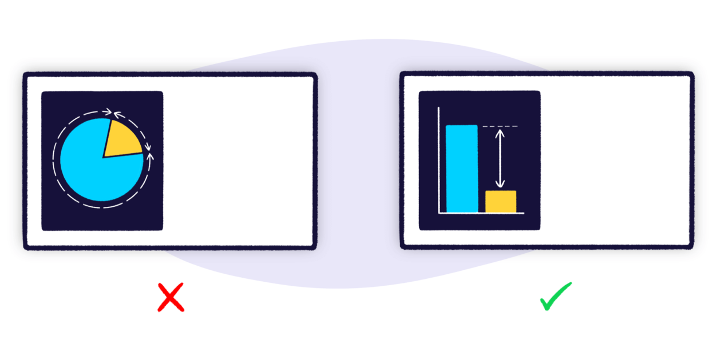
Use the most efficient visualization
When selecting a visualization, you should choose the one which most clearly and efficiently communicates your data.

Slide 9
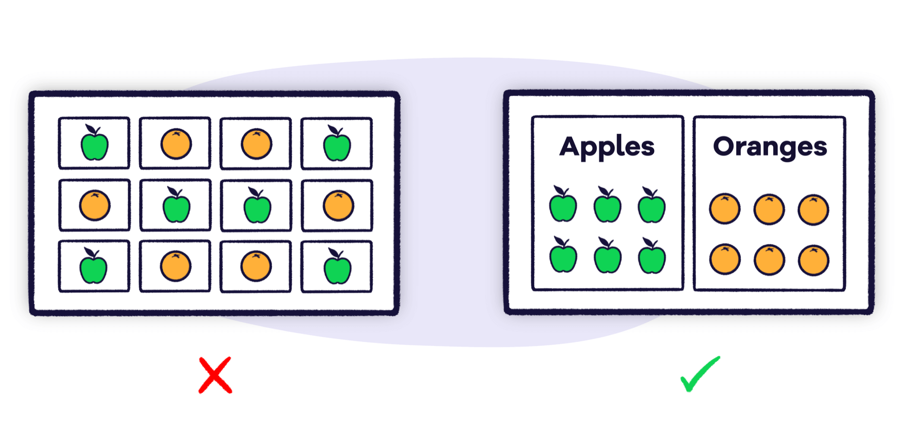
Group your related metrics
It’s important to position the information on your dashboard logically.

Slide 10
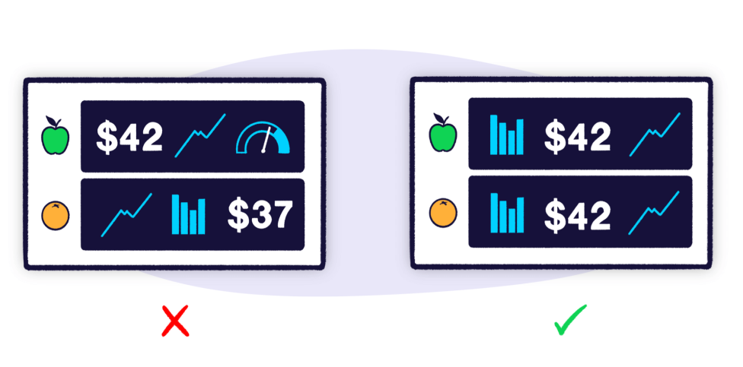
Be consistent
With dashboards, it’s often necessary to be repetitive, especially when you’re showing the same set of metrics for multiple things.

Slide 11
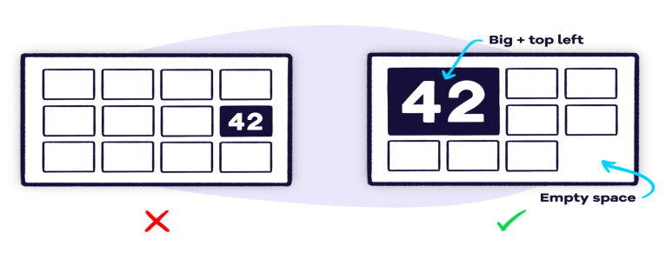
Use size and position to show hierarchy

Slide 12
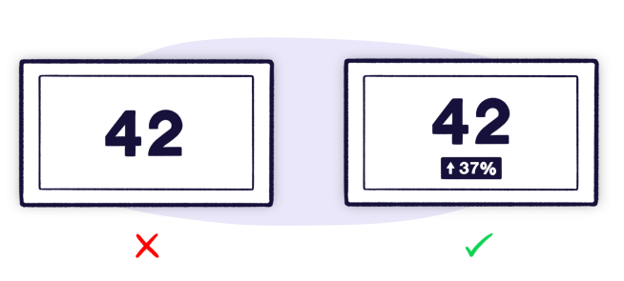
Give your numbers context

Slide 13
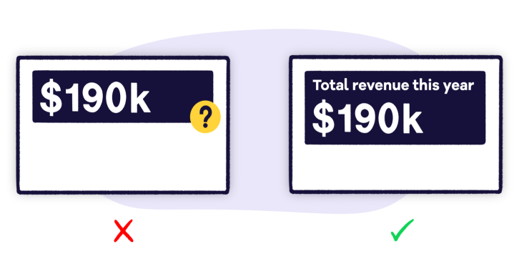
Use clear labels your audience will understand
A key part of your dashboard are the labels that describe each metric or chart.

Slide 14

Remember it’s for people
rules are made to be broken.
Dashboard design is about more than just how efficiently you can lay out data.
Ultimately, it’s about getting people to engage with the information.

Slide 15
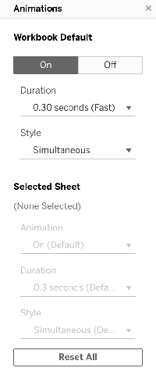
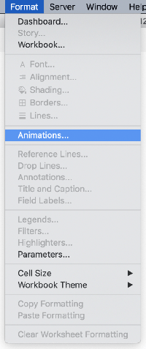
2. Add motions
you can use the page output to create a motion chart.

Slide 16
3. Adding interactivity with actions
Tableau is one of the most popular suites of Business Intelligence and Data Analytics tools used by various enterprises around the world.
There are a number of features such as filters, measured names, in-memory data, a myriad of data sources, actions, advanced visualizations, maps, robust security, trend lines, and more that makes Tableau a better choice.

Slide 17
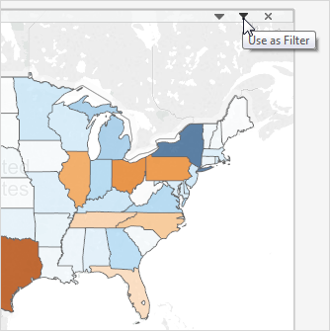

Slide 18
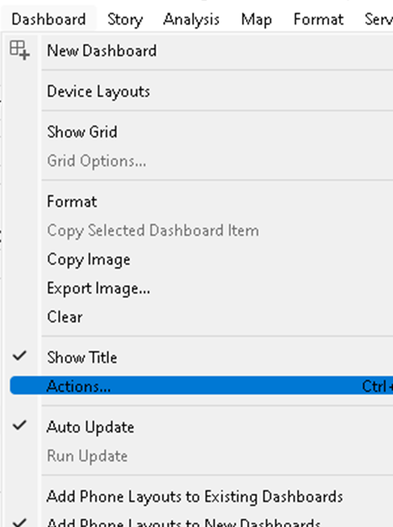
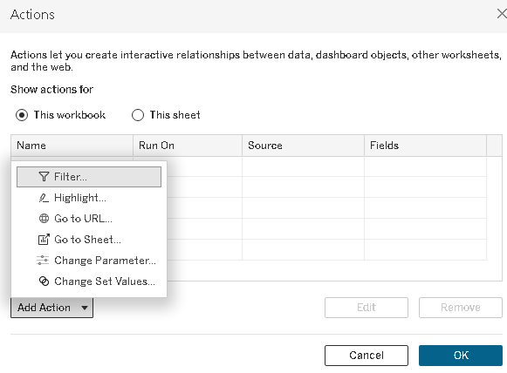
From your dashboard, select Dashboard > Actions.
In the Actions dialog box, click Add Action and then select Go to Sheet.

Slide 19
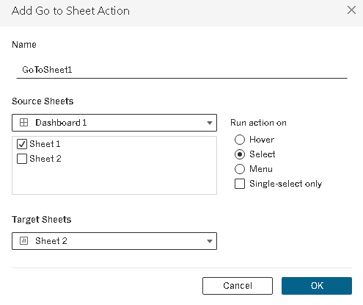
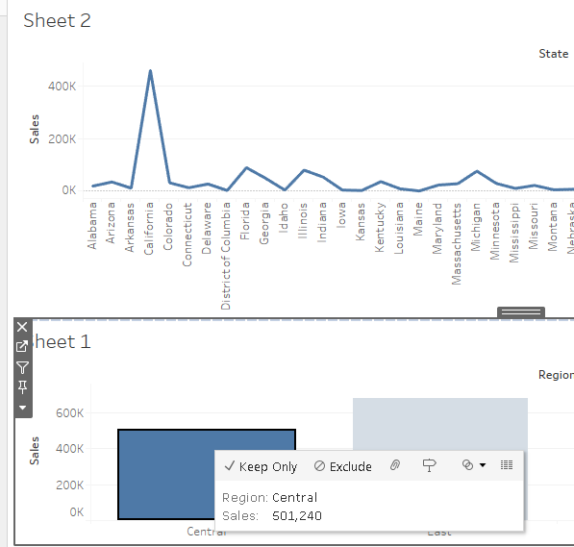
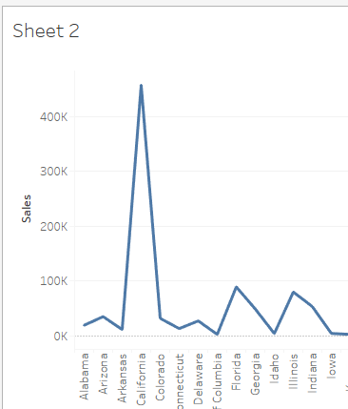

Slide 20
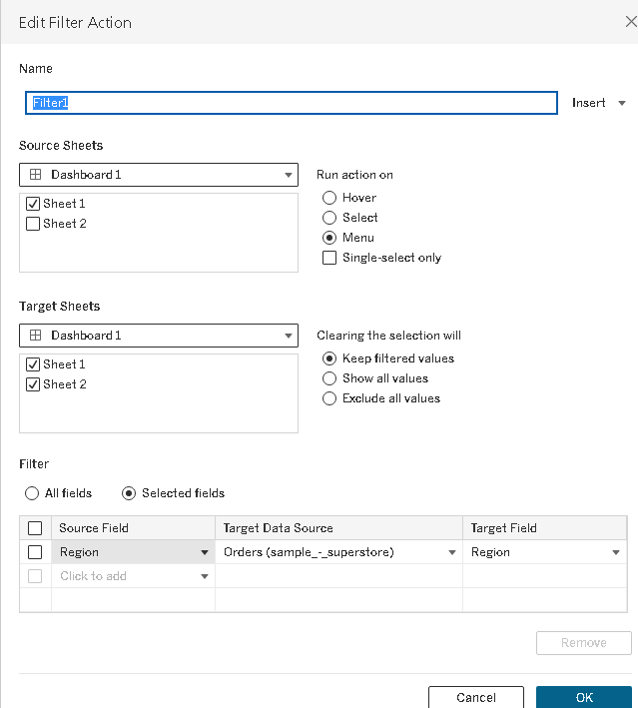
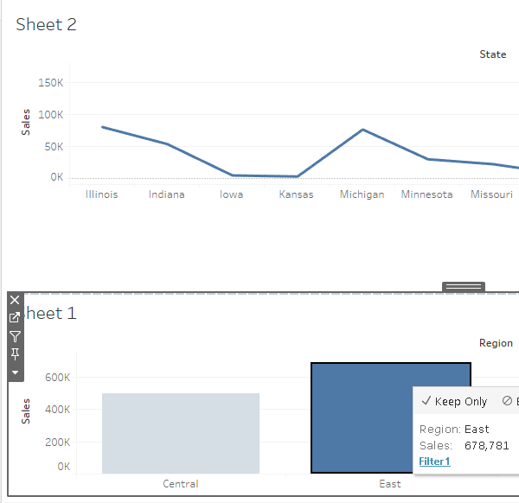

Slide 21
4. Dashboard layout and formatting
A best practice is to start with setting the size so any layout work starts at the correct size.
Dashboard size options
Fixed size (default): The dashboard remains the same size.
Range: The dashboard scales between the minimum and maximum sizes that you specify. If the window used to display the dashboard is smaller than the minimum size, scroll bars are displayed. If it's larger than the maximum size, white space is displayed.
Automatic: The dashboard automatically resizes to fill the window used to display it.

Slide 22
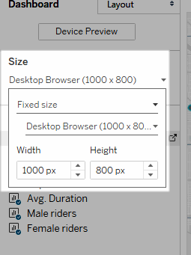
4.1 Set overall dashboard size
Under Size on the Dashboard pane, select the dashboard's dimensions (such as Desktop Browser) or sizing behavior (such as Fixed size).
Group items using layout containers
Layout containers let you group related dashboard items together so you can quickly position them.
As you change the size and placement of items inside a container, other container items automatically adjust.
Layout containers can also be used for formatting.

Slide 23
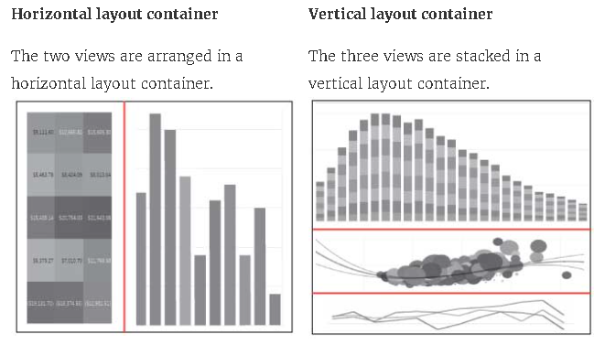

Slide 24
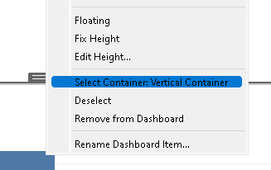
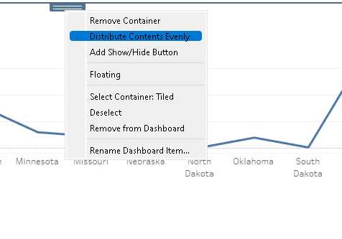

Slide 25
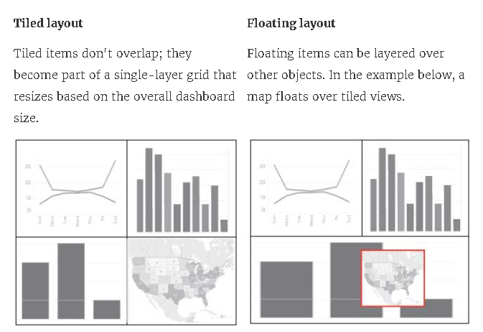

Slide 26
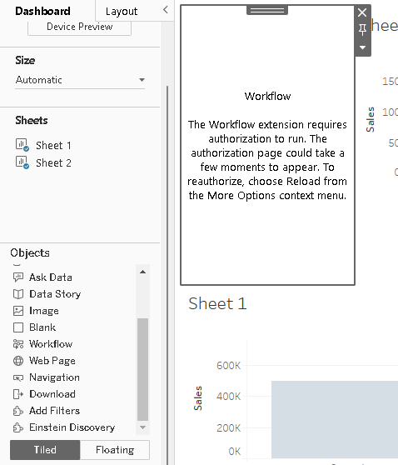
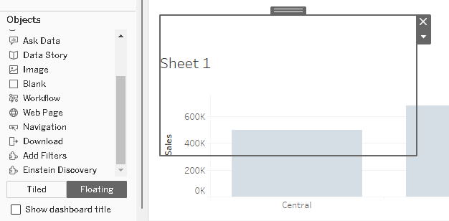

Slide 27
5. Add extra detail to visualization using Marks Shelf
Size
Shape
Labels
Details
Tooltips

Slide 28
To add extra detail to a visualization using the Marks card in Tableau:
Color: Assign a field to the color property to differentiate data points by region.
Size: Assign a quantitative measure to the size property. For example, you can assign sales values to the size of circles.
Shape: Encode marks with shape.
Text: Encode marks with text.
Detail: Drop a dimension on Detail on the Marks card to separate the marks in a data view according to the members of that dimension.
Label: Edit the label text.
Header: Drag a discrete dimension and drop it to either side of an existing header, or to the left of an axis.
Multiple fields on the color shelf: Put the second field onto detail, and then add it to color.

Slide 29
6. Sharing and collaborating dashboards
Sharing Your Dashboard Offline with Tableau Desktop
File’ > ‘Save As.’
Choose Tableau Package Workbook (*.twbx) and save it to your desktop.
Download Tableau Reader and import your file.
Sharing Your Dashboard Online via Tableau Public
‘Server’ > ‘Tableau Public’ > ‘Save to Tableau Public As…’
Name your file, click save, and wait for Tableau to process your request.
Once published on Tableau Public, you can share your dashboard with a link.

Slide 30
Publish your dashboard in seconds, making it easy for everyone in your organization to see your insights, ask questions, and make decisions.
Fully hosted by Tableau: If you don’t want to install software or purchase hardware, choose analytics as a service with Tableau Cloud.
Deploy on the public cloud: If you prefer not to manage on-premises servers but want full control of your software, deploy Tableau Server (on Windows or Linux) on Amazon Web Services, Google Cloud Platform, or Microsoft Azure

Slide 31
7. Story Points and how to create them
Use stories to make your case more compelling by showing how facts are connected, and how decisions relate to outcomes.
You can then publish your story to the web, or present it to an audience.
Each story point can be based on a different view or dashboard, or the entire story can be based on the same visualization seen at different stages, with different filters and annotations.

Slide 32
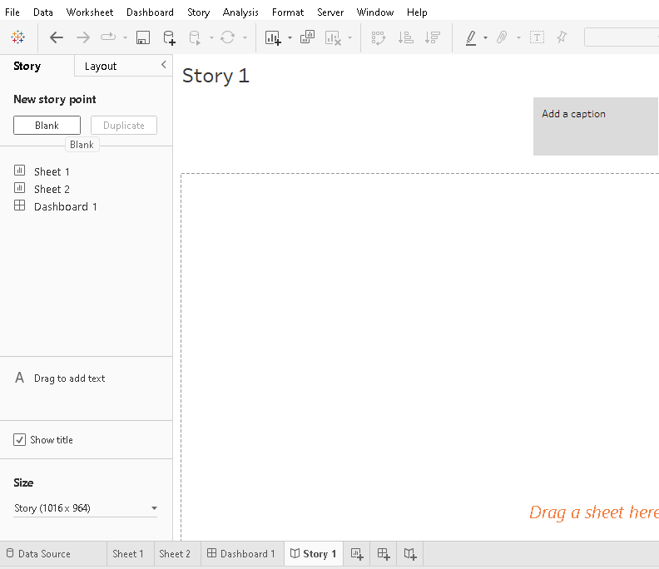

Slide 33
When you add a sheet to a story point, that sheet remains connected to the original sheet. If you modify the original sheet, your changes will automatically be reflected on the story points that use it.

Slide 34
8. Designing effective slide presentations to showcase data story
Start with the end in mind: Stakeholders are often impatient, so get to the point.
Use appropriate visualizations: Charts and graphs should clearly show the data without bias.
Apply effective design principles
Use stories to show how facts are connected: This can make your case more compelling

Slide 35
Presentation approach
Visualizations shown in the slides were not referenced: The presenter talked over their charts and graphs without making explicit references to them.
No story or narrative: The presentation was primarily informational and delivered as a report.
Lack of audience engagement: The presenters did not include opportunities for audience interaction, questions, or dialogue.
Little or no audience eye contact: Presenters looked past the audience or down at their notes instead of engaging with their addressees.
Over the time limit: The presenters did not complete their presentation within the time allotted.
Too much information: The presenters provided too much information on their slides. The guideline is six words per line, and no more than six lines of text.

Slide 36
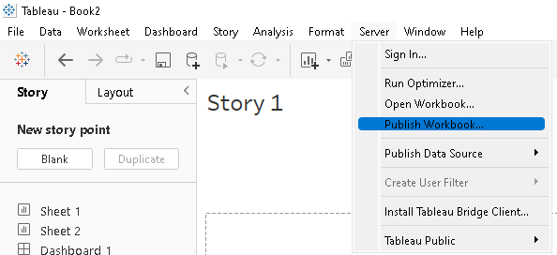
9. Publish online business dashboards

Slide 37
10. Exporting Pdfs, Sharing Dashboard Securely
To publish to PDF:
If you want to specify which elements are printed to the PDF file, and how they're laid out, select File > Page Setup. For more information, see Printing Worksheets.
Select File > Print to PDF.
In the Print to PDF dialog box, select the print range:
Entire Workbook - publishes all the sheets in the workbook.
Active Sheet - publishes only the sheet currently displayed in the workbook.
Selected Sheets - publishes the selected sheets.

Slide 38
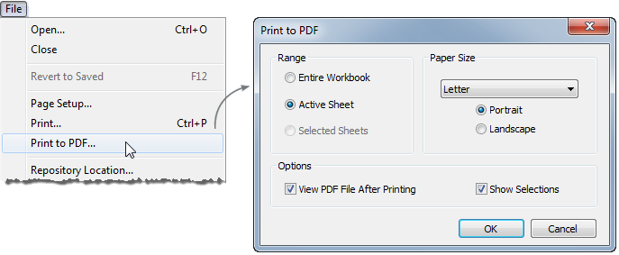
Select a paper size and orientation. If you select unspecified, the paper size will be as large as necessary to show the entire view on a single page.
Optionally select View PDF File After Printing if you want to automatically open the PDF when you are done printing. This option is only available if you have Adobe Acrobat Reader or Adobe Acrobat installed on your computer.
Optionally select Show Selections if you want to include selected marks and highlighting in the PDF.
Click OK and select where you want to save the PDF. Then click Save.
Optionally specify the Page Setup for each sheet in the workbook before publishing to PDF.

